Slide 1

Rockbuster Stealth LLC Launch Strategy
Tana Tamaki

Slide 2
How to Stay Competitive?
Rockbuster Stealth LLC, once prevalent around the world now faces tough competition from streaming services.
In order to stay competitive, existing movie licenses will be used to launch an online video rental service.
Objectives:
Provide data-driven answers to key business questions to guide the upcoming launch of services.

Slide 3
Key Business Questions
In Which countries are Rockbuster customers based?
Where are customers with a high lifetime value based?
Which movies contributed the most/least to revenue gain?
How do sales figures vary across different geographic regions?

Slide 4

Current Statistics
Average
Rental Duration: 4.9 days
Replacement Cost: $19.98
Film Length: 115.27 minutes
Minimum
Rental Duration: 3 days
Rental Rate: $0.99
Replacement Cost: $9.99
Film Length: 46 minutes
Maximum
Rental Duration: 7 days
Rental Rate: $4.99
Replacement Cost: $29.99
Film Length: 185 minutes
Rental Rate: $2.98
We offer 1000 films.
(958 unique titles)
Average rental duration is ~5 days.
Average payment is $4.20.

Slide 5
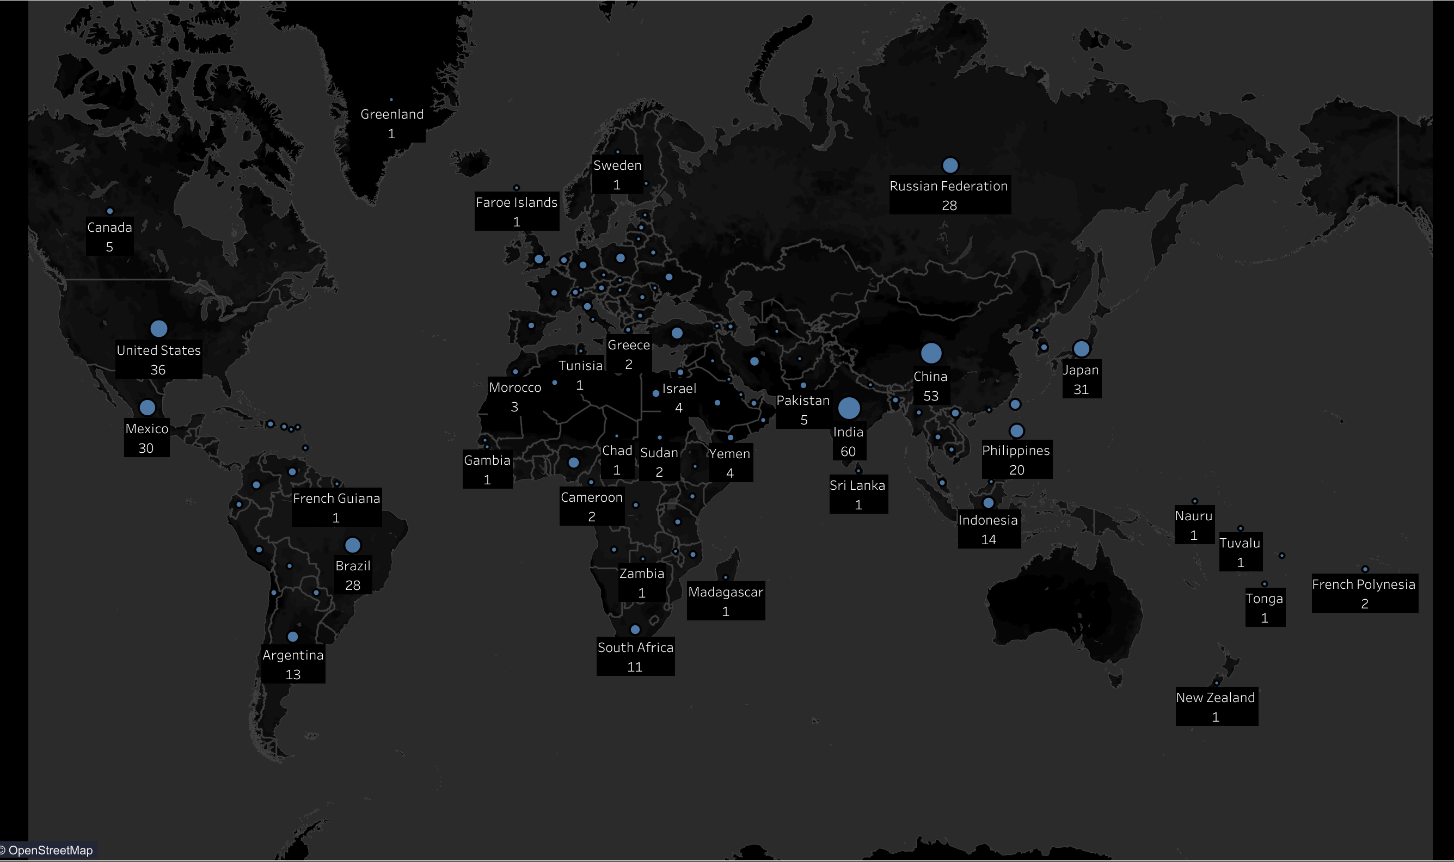
In Which Countries are Rockbuster Customers Based?
Currently have 599 customers located in 108 countries.
We have customers in most continents, except Australia and Antarctica.

Slide 6
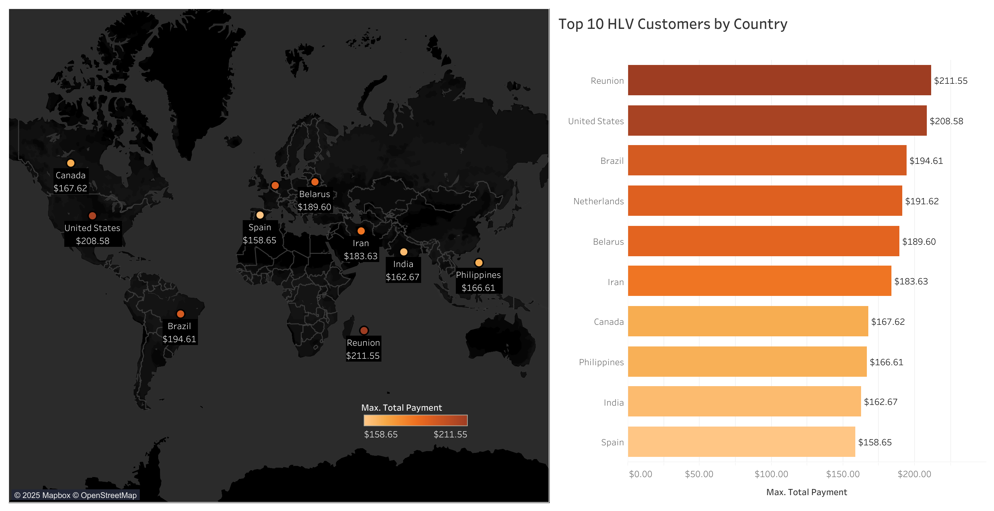
Where are Customers with a High Lifetime Value Based?
These are the top 10 countries with the highest paying customers.
Among them are the U.S., Brazil, and the Reunion Islands.
Understanding where customers with a high lifetime value are located, can help us target similar audiences while aiming to retain these valuable customers.

Slide 7
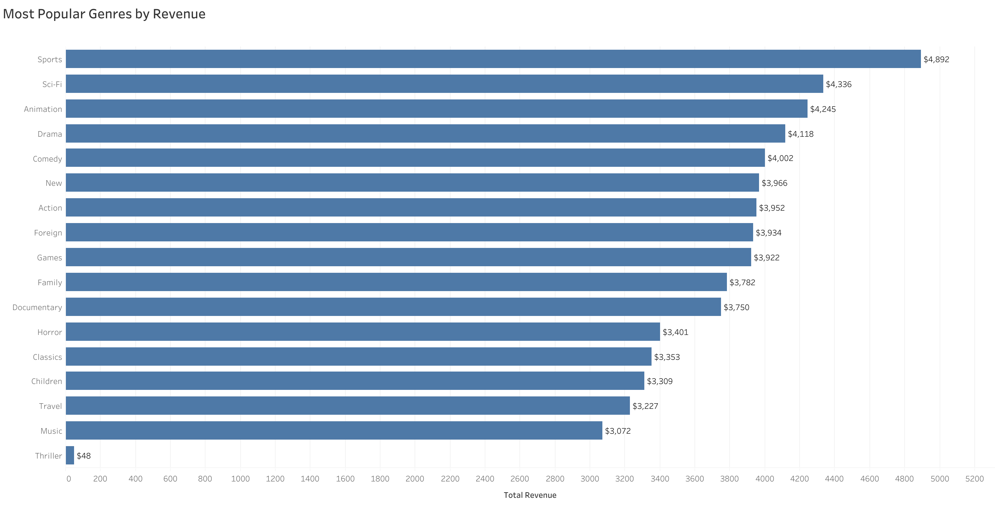
Which Movies Contributed the Most/Least to Revenue Gain?
Top 3 Genres with the Most Revenue:
Sports
Sci-fi
Animation
Thiller films were the least profitable genre.

Slide 8
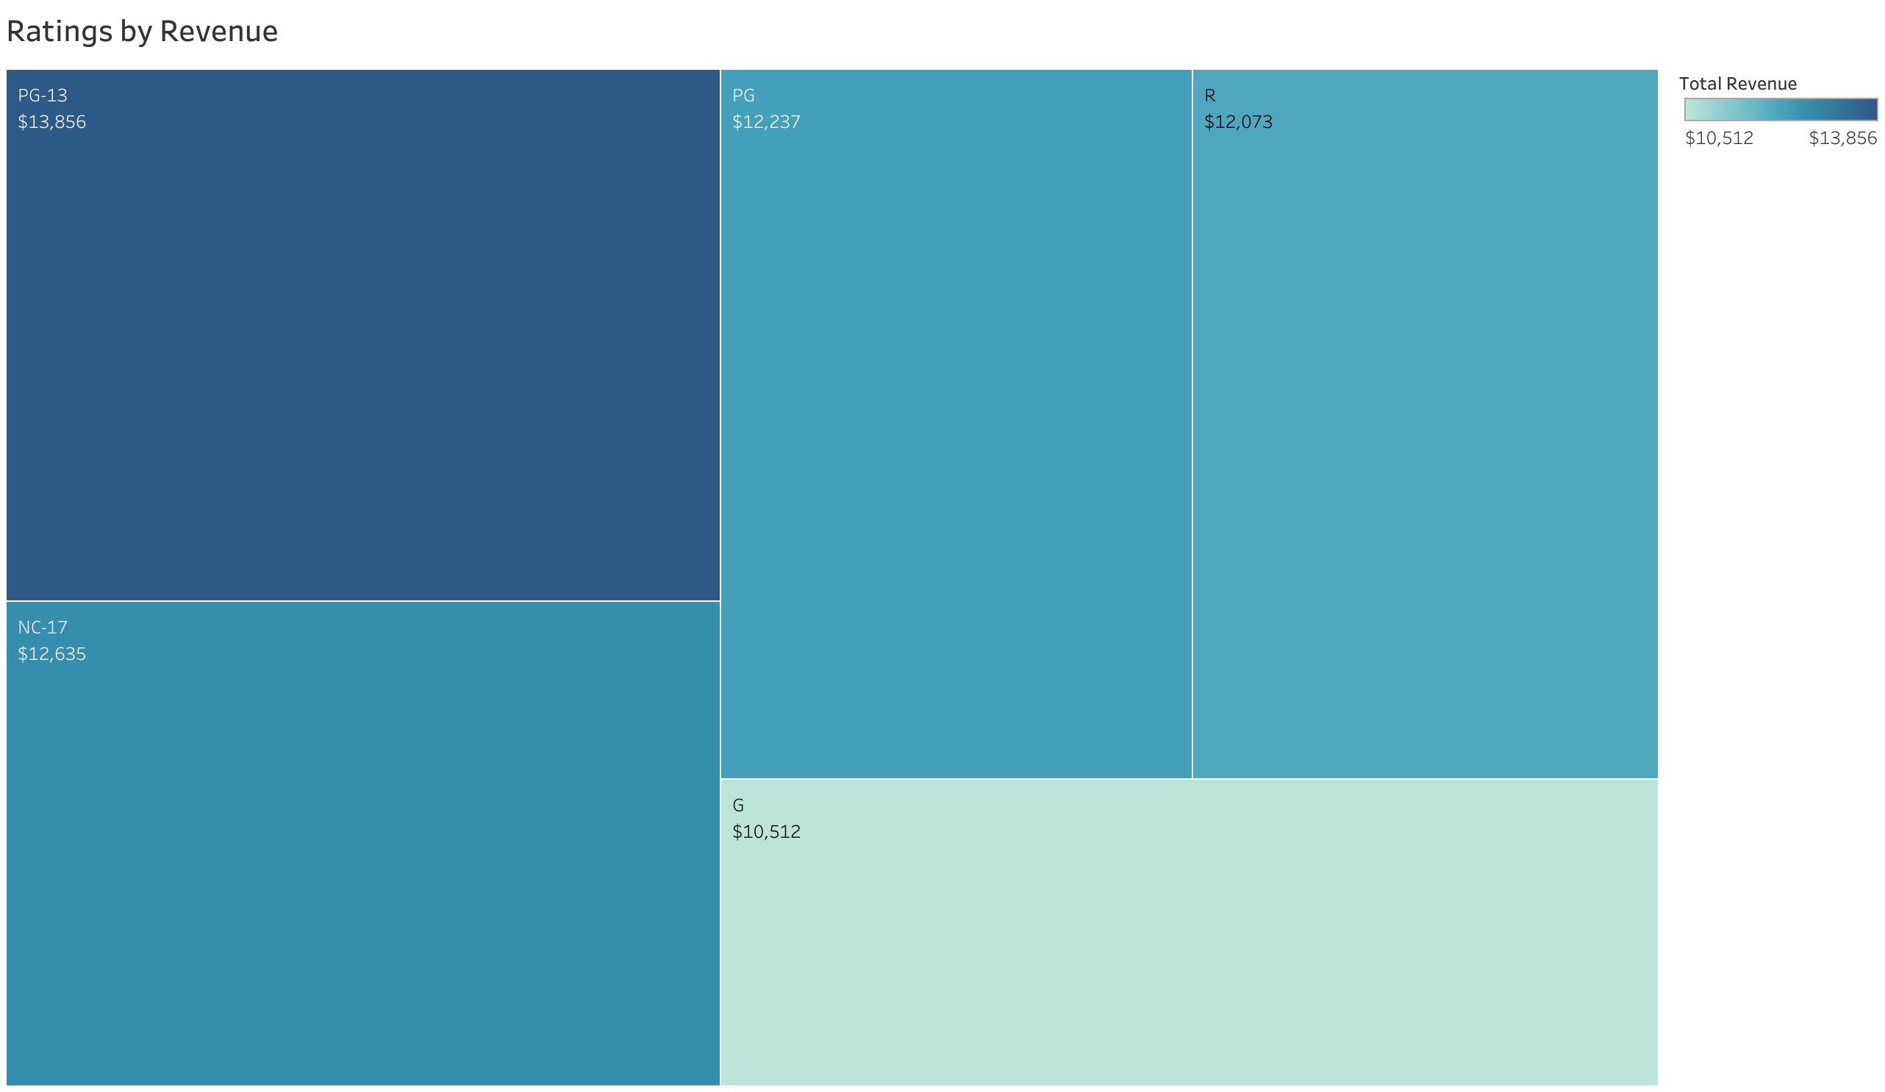
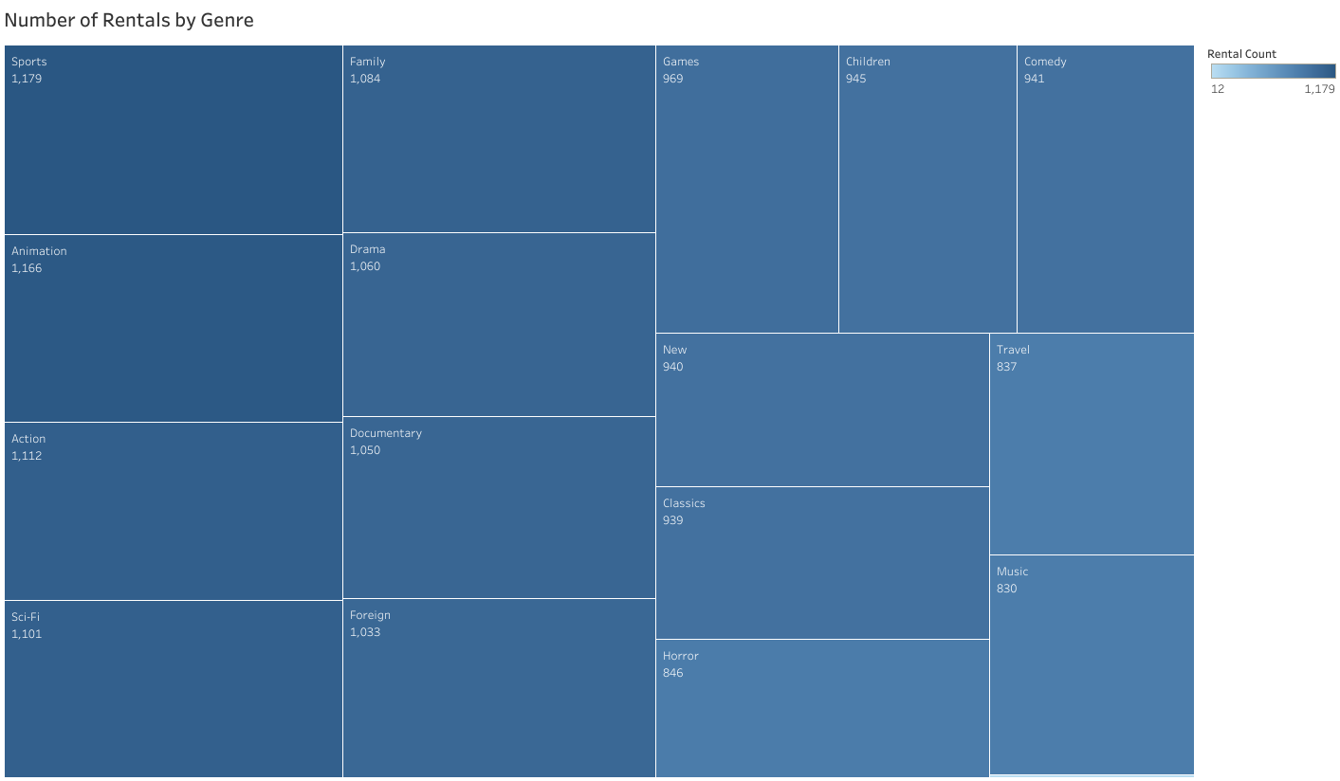
Which Movies Contributed the Most/Least to Revenue Gain?
Films rated PG-13 garnered the most revenue among all the ratings.
NC-17 and PG rated films closely followed.
Sports, Animation, and Action films were the most rented genres.
Thriller films were the least rented genre.

Slide 9
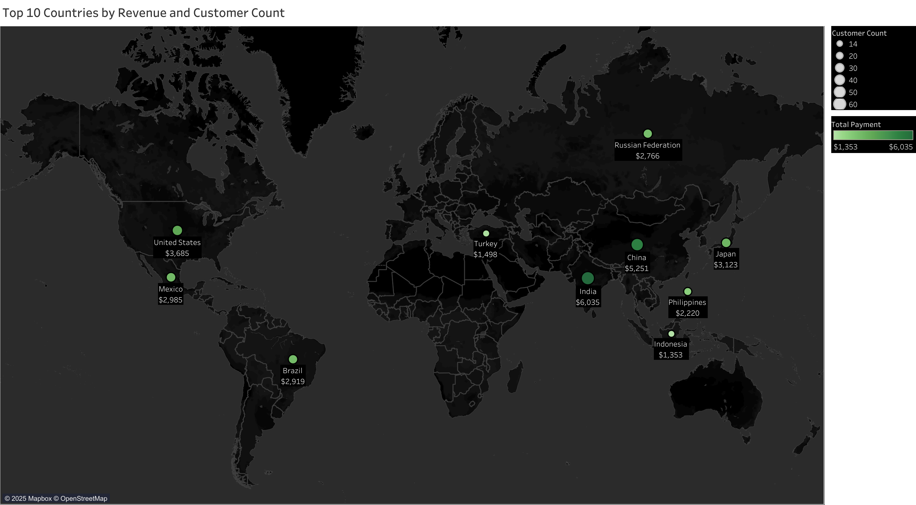
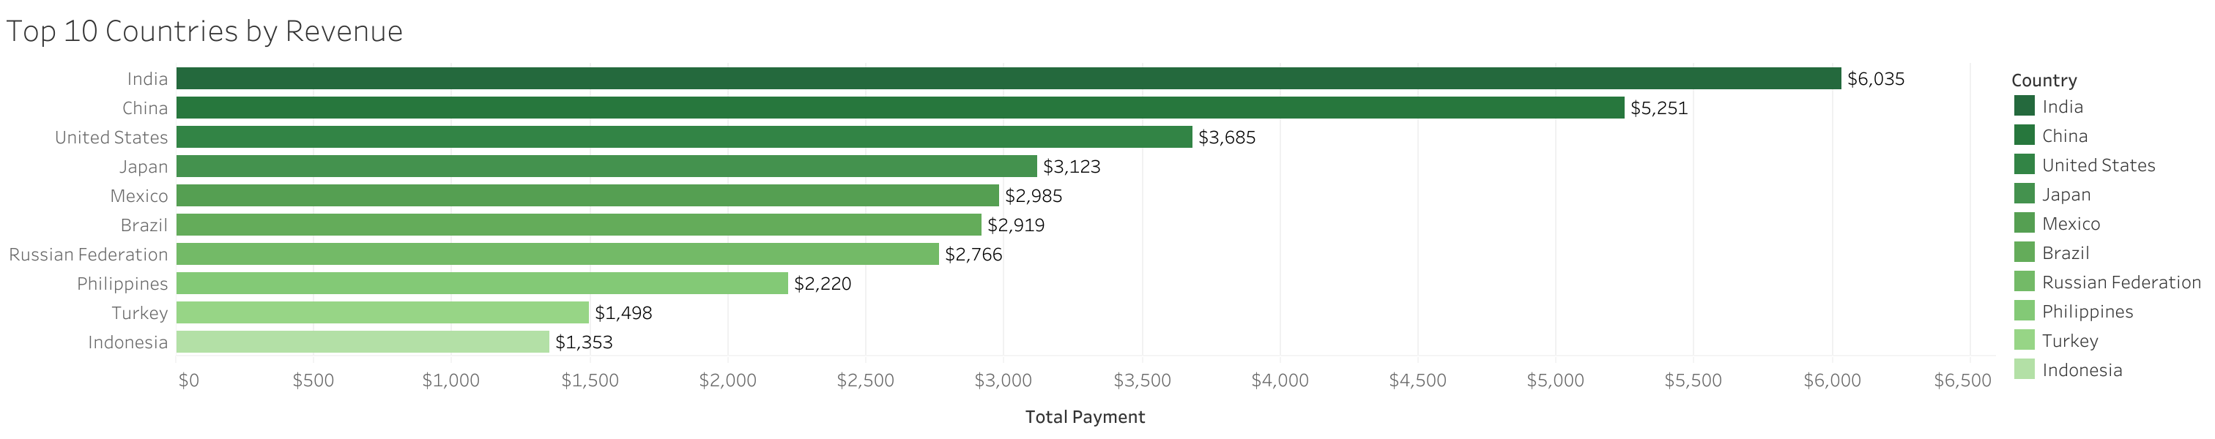
How do Sales Figures Vary Across Geographic Regions?
These are the top countries based on the number of customers and total revenue.
The top three highest grossing countries with a strong customer base are India, China, and the U.S.

Slide 10
Insights
Films rated PG-13 produced the most revenue among all rating categories.
Sports, Sci-Fi, and Animation were the top three genres by total revenue.
Focus on HLV countries (U.S, Brazil, Reunion Islands) to boost customer retention.
The United States, India, and China have the largest customer bases and are among the top revenue producing countries.

Slide 11
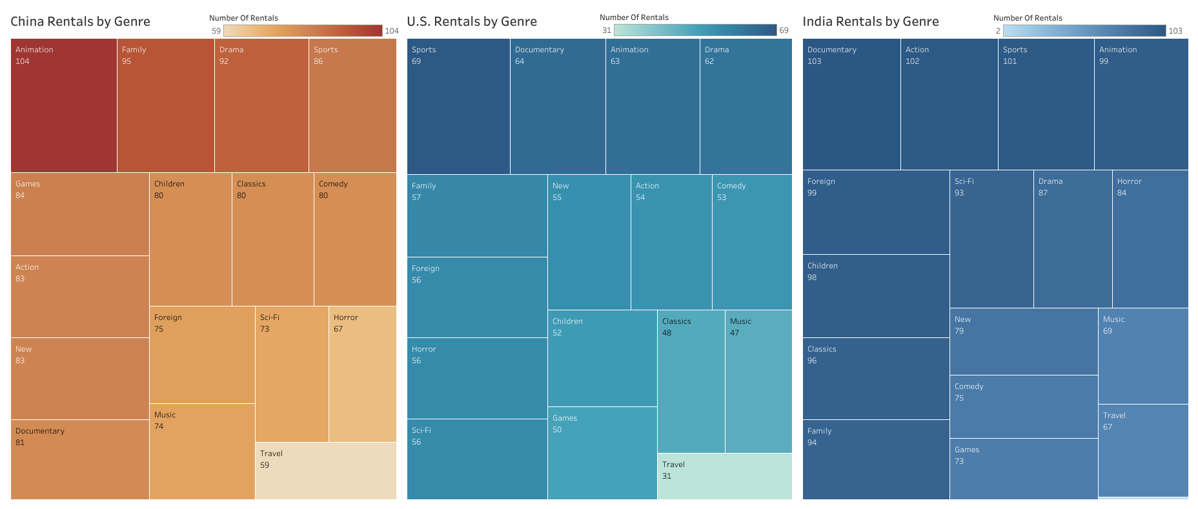
Recommendations: Where to Invest in the Top 3 Revenue Producing Countries?
The most rented genres in China are Animation and Family films.
Sports films are popular in the U.S.
Action films were among the most rented in India.
Documentaries are popular in both the U.S. and India.

Slide 12
Recommendations and Next Steps
We currently lack a customer base in Australia and should analyze local demographics to find what films could be popular to aid in expansion efforts.
Popular genres and films rated PG-13 seem to appeal to a wide audience and should be prioritized in marketing campaigns.
Investigate why genres like thrillers are underperforming and consider reallocating funds to expand inventory of genres with strong earning potential such as Sports films.
Increase current investments in regions with high LTV customers and revenue producing countries, particularly in the U.S, India, and China.

Slide 13

Thank You!
Tableau Link: https://public.tableau.com/app/profile/tana.tamaki/viz/RockbusterLaunchStrategyStoryboard/RockbusterStoryboard#1

